Slide 1

Modal verbs
Modale werkwoorden

Slide 2
What are they?
Verbs that indicate likelihood, possibility, ability and obligation
Who’s that at the door? It could/may/might/must/should/can’t/will be John. (express attitude or opinion)
Common modal verbs are:
Must very likely (certain)
May
Might
Can
Could
Would
Should very unlikely

Slide 3
What do they mean?
Modal verbs can have multiple meaning, depending on the main verb in the sentence.
He must be rich. = logical conclusion
You must pay for the bill. = have to, obligation
You may see the president. = it is possible that …
If I may excuse myself. = if I’m allowed to…
Could I borrow your homework? = permission
I could get a different shirt. = possibillity

Slide 4
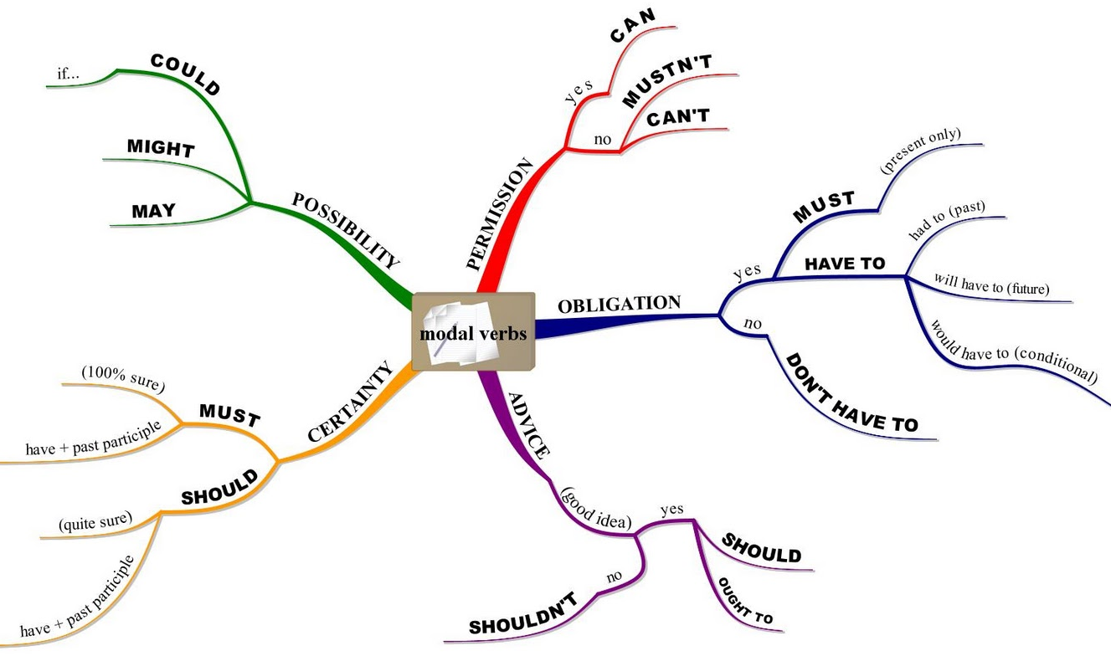

Slide 5

Form
Modal verbs do not take "-s" in the third person (he/she/it).
He can speak Chinese.
She should be here by 9:00.
Modal verbs are always followed by the infinitive.
He might be late.
She should give you a call.

Slide 6
Extra practise
http://www.learnenglish-online.com/grammar/modals/tests/modaltest2.html
http://www.englishpage.com/modals/interactivemodal1.htm
http://www.perfect-english-grammar.com/modal-verbs-exercises.html
http://www.eslgamesplus.com/modal-verbs-can-could-might-must-should-would-catapult/

